Slide 1
Experiment -06
Creation of Multithreaded Processes using Pthread Library

Slide 2
Threads
It is single sequential (flow of) execution of tasks of process
A thread (or lightweight process) is a basic unit of CPU utilization; it consists of:
program counter
Thread id
register set
stack space
A thread shares with its peer threads its:
code section
data section
operating-system resources

Slide 3
Benefits of Threads vs Processes
Less time to create a new thread than a process, because the newly created thread uses the current process address space.
Less time to terminate a thread
Less time to switch between two threads - newly created thread uses the current process address space.
Less communication overheads - threads share everything: address space, So, data produced by one thread is immediately available to all the other threads.

Slide 4
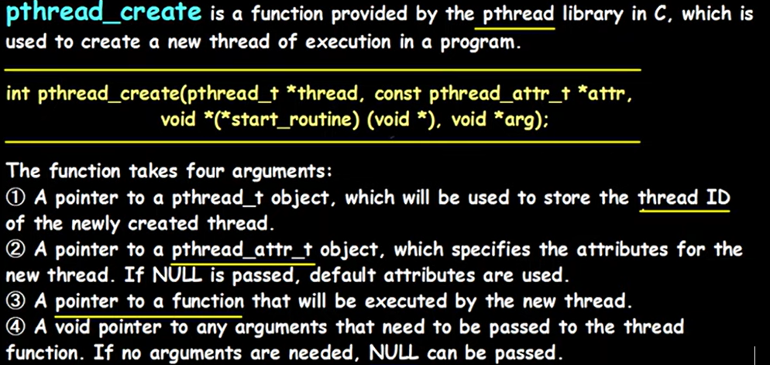
pthread_create

Slide 5
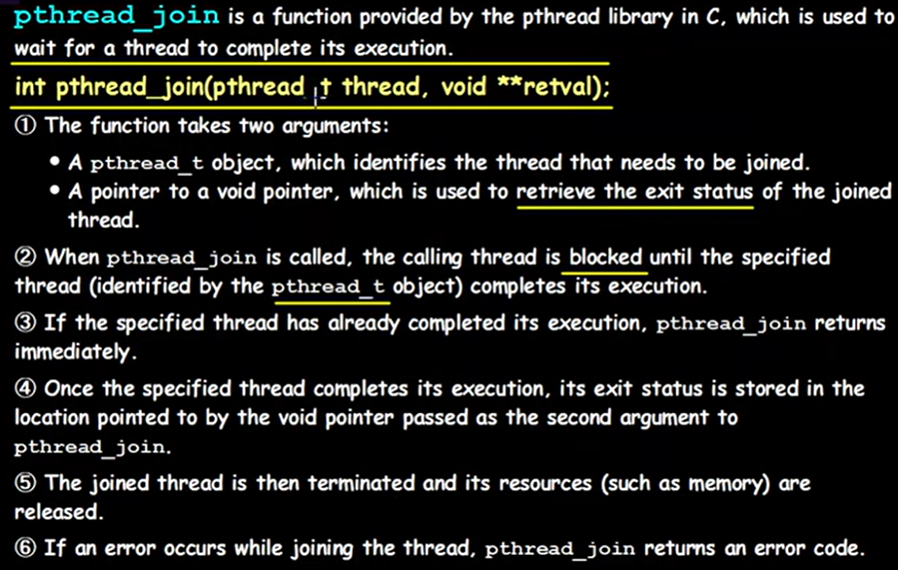
pthread_join

Slide 6
pthread_exit(): - is used to return a value from the thread back to the main process.
pthread_join: - suspends execution of calling thread until target threads completes
execution.

Slide 7
How to pass value to a thread
How to pass value to a thread
How to return something from thread that to the main process

Slide 8
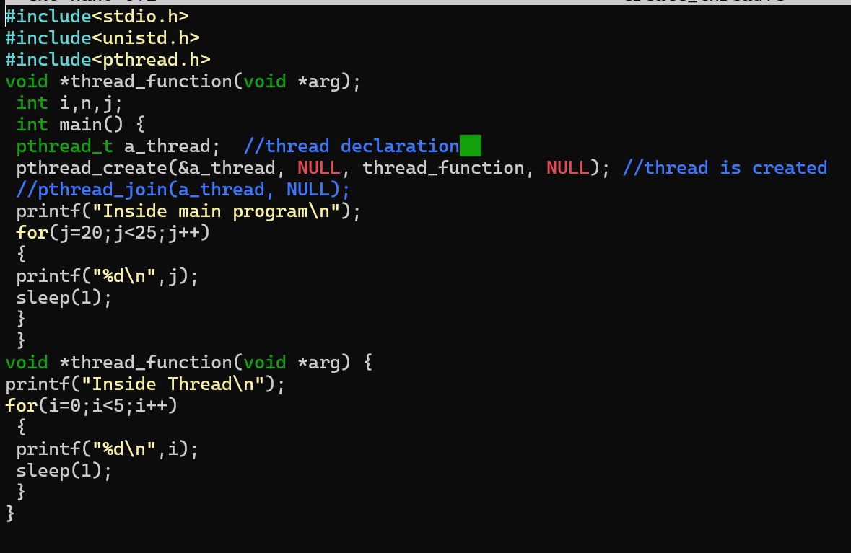
Creation of a thread

Slide 9
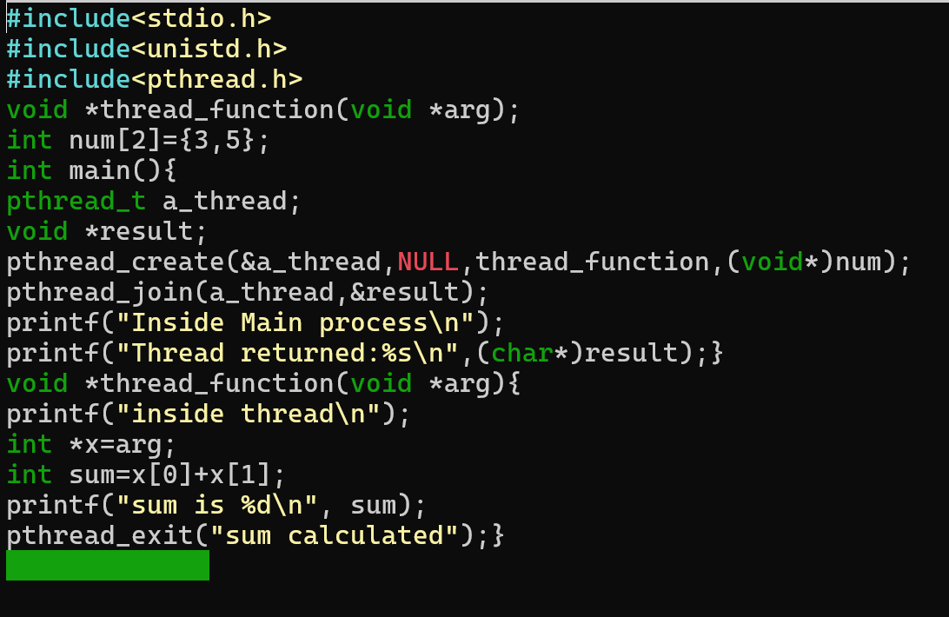
Creation of a thread

